Slide 1


General Biology lab
Al-Karkh University for Science
Collage of Science
Microbiology Department
Dr. Rawa Abdul Redha Aziz
Ph.D Antibiotics/ Molecular biology
Laboratory Staff:
1. Lecturer Dr. Rawa Abdul Redha Aziz
2. L. assistant Sura Alaa Saud
3. L. assistant Gada Readh
Supervised by:
1. Prof. Munira Ch. Ismaeel
2. Ass. Prof. Israa AJ Ibrahim

Slide 2
Lab 6: Medial preparation
- Culture media is a solid or liquid preparation used to grow , transport and store microorganisms. To be effective , the medium must contain all the nutrients that are required for growth. The basic nutritional requirement including:
1. Energy source
2. Carbon source (contain carbon)
3. Nitrogen source
A. organic compound (amino acid)
B. inorganic compound NO₂,NO₃,and NH₄)
4. Sulfur and phosphor (important for production of nucleic acid and proteins)
5. Mineral
A. macro elements: require in small amount e.g. Mg, Fe, Ca, and K)
B. requires in small amount e.g. Zn, Cu, Mn, Co, Mo, and Ni.

Slide 3
Types of Media
Synthetic media: Such a medium in which all components are known.
Complex media: Media that contain some ingredients of unknown chemical composition , such as : (blood agar , Nutrient broth ).
Liquid media: Nutrient broth .
Solid media: Nutrient agar .Agar : It is extracted from red algae milted in 80-90⁰C and solidified at 45⁰C.
Semi solid media: content 0.5 gm % agar. It is used to determine bacterial motility.
Enriched media: Used to encourage the growth of fastidious bacteria.
e.g. Blood agar , tetrathionate broth)for salmonella isolates).
Selective media: Favor the growth of particular M.O.s Bile salts or dyes like basic fuchsin and crystal violet favor the growth of gram–negative bacteria by inhabiting the growth of gram-positive bacteria without affecting gram-negative organism. e.g.(Eosin methylene blue agar, MacConky agar).
Differential media: Are media that distinguish between different groups of bacteria .

Slide 4
Broth tubes: are tubes containing a liquid medium. A typical nutrient containing broth medium such as Trypticase Soy broth , nutrient broth After incubation, growth may be observed as one or a combination of three forms:
Pellicle: A mass of organisms is floating on top of the broth.
Turbidity: The organisms appear as a general cloudiness throughout the broth.
Sediment: A mass of organisms appears as a deposit at the bottom of the tube.
Slant tubes: are tubes containing a nutrient medium plus a solidifying agent, agar-agar. The medium has been allowed to solidify at an angle in order to get a flat inoculating surface.
Stab tubes: (deeps) are tubes of hardened agar medium which are inoculated by "stabbing" the inoculum into the agar.
Agar plates: are sterile petri plates that are aseptically filled with a melted sterile agar medium and allowed to solidify.

Slide 5
Materials :
Electronic balance
D.W (distilled water)
media
Autoclave
Petri dish
cotton blug
sprit lump
Hot plate
Procedure:
Weight X gm media
dissolve in X ml D.W.
Boiling at hot plate.
Then sterilize by autoclaving for 15 min. at 121°C. Cool to 47°C, then pour plates

Slide 6
Type of media:
Diagnosis |  | Function | Component | media
Hemolytic β , α or γ |  | Growth fastidious bacteria | Blood agar base, 5% Blood | Blood agar
Growth Neisseria spp , Haemophilus |  |  | Blood agar base, 5% heated blood | Chocolate agar
E.coli colonies ( Green- blue) |  | Isolation lactose ferment and non-lactose ferment Enterobacteriaceae | Peptone, lactose, sucrose, methylene blue | EMB (Eosin methylene blue)
Lactose fermenter bacteria :pink color Non-lactose fermenter:colorless bacteria(or yallow) |  | Isolation lactose ferment and non-lactose ferment Enterobacteriaceae | Peptone, lactose, crystal violate, bile salt(G+ inhibiting), neutral red (indicator ) | MacConkey agar
Mannitol fermenter bactria:yellow color |  | Selective media for isolated Staphylococcus | Peptone, mannitole, phenol red(indicator), salt conc.7.5% | Mannitol salt agar
Yellow colonies have black center |  | Isolation Salmonella, Shigella | Peptone, lactose, ferric citrate, sodium citrate, neutral red, brilliant-green &bile salts | Salmonella-Shigella agar( SSA)
Selective media (Salmonella , Shigella) |  |  | Peptone, bile salts, sodium- thiosulphate (Enterobacteriaceae inhibiting) | Tetrathionate broth
During fermenter appear yellow color while produce H2S appear (black sediment) | Distinguishes between Enterobacteraceae |  | Peptone, lactose 1% sacchrose 1% glugose 0.1% phenol red ,ferrous sulfate | T.S.I Triple sugar iron agar
Dark pink | Produce NH4 by hemolytic urea ex. Proteus spp. |  | Peptone, glucose, KH2PO4, phenol red, Urea enzyme | Urea agar
Red ring (using Kovacs reagent) | Indole production Enterobacteraceae |  | Tryptophan | Indol test
Blue color | Utilize carbohydrate Enterobacteraceae |  | Sodium citrate, Bromothymol blue | Citrate agar
 |  |  |  | Indicator
acid media: Red color basic media: yellow color |  |  |  | Neutral red
acid media :yellow color basic media: pink color |  |  |  | Phenol red
acid media :yellow color basic media: blue color |  |  |  | Bromo thymol blue

Slide 7
Isolation of Pure Cultures
In nature, bacteria rarely occur as pure cultures. Streak plate methods can separate most mixed cultures. As showed in the figure below, there are three streak ways. This will progressively dilute the bacteria so that the end of the third streak deposits isolated cells onto the agar. Each cell then divides and grows into a pure colony or clone.

Slide 8
Materials
Each student/team:
(1) Sterile vial (3-5 mL).
(1) Sterile rubber band.
(1) Nutrient agar plate.
Procedure
1. Overnight of 1 mL Bacterial suspension.
2. Using sterile loop to take a loop full from the suspension
3. Streak the loop full on a nutrient agar plate as shown the following figure.
4. Flame the loop and allow it to cool. Make the second streak by first streaking over the end of the first streak, and then continuing the streak without touching the first one.
5. Repeat step four by overlapping the second streak and then finishing the plate.
6. Incubate the plate for 24 to 48 hours at 37°C

Slide 10
Important Concepts:
Contaminants: other microorganisms present in the sample.
Isolated colonis: a population of millions of cells that are identical and are descendent from a single founder cell
Stock Culture: a culture that already contains cells. It is used a source of cells from which to inoculate new cultures.

Slide 11
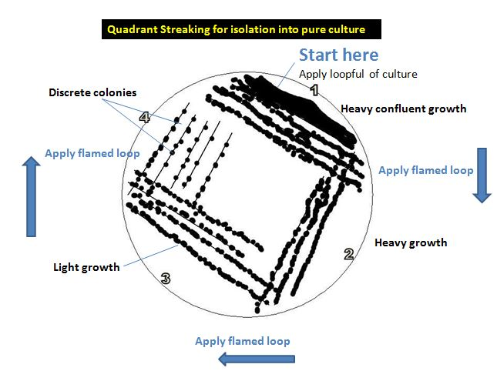
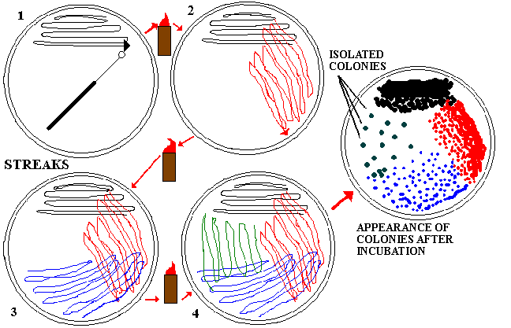
Figure 1 (b): Quadrant Streaking Method

Slide 12
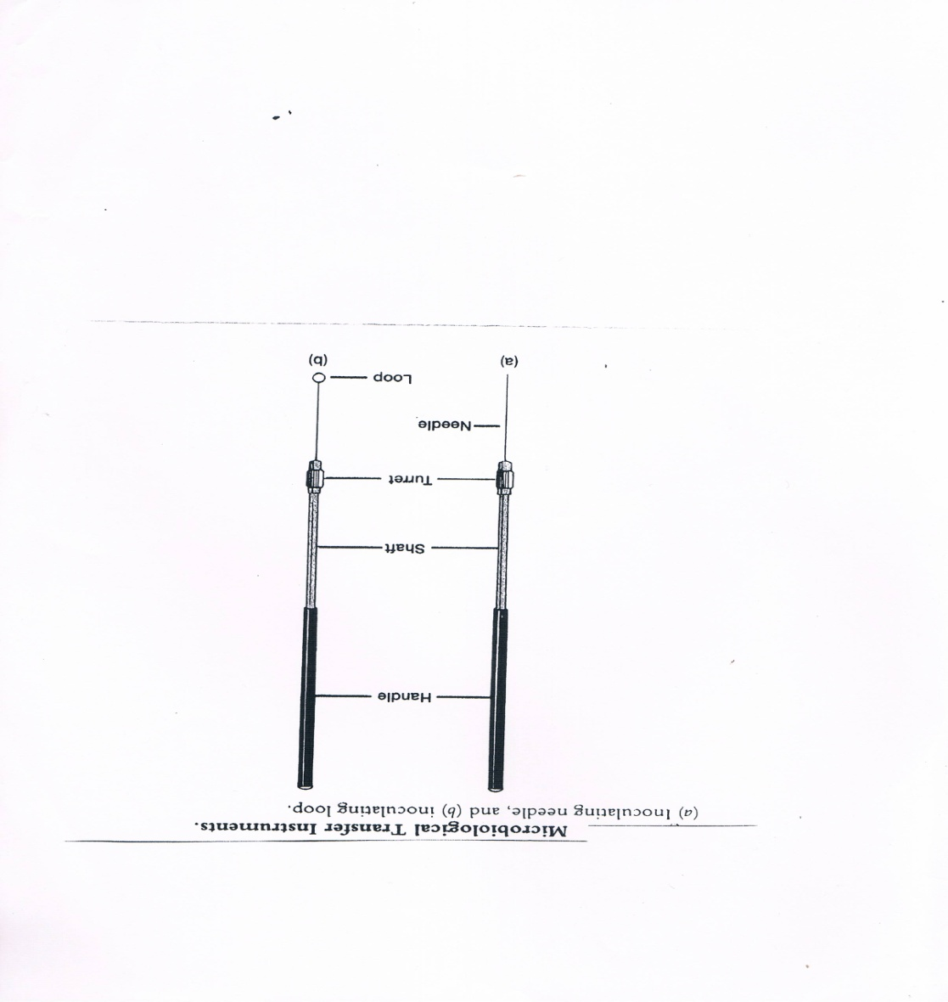
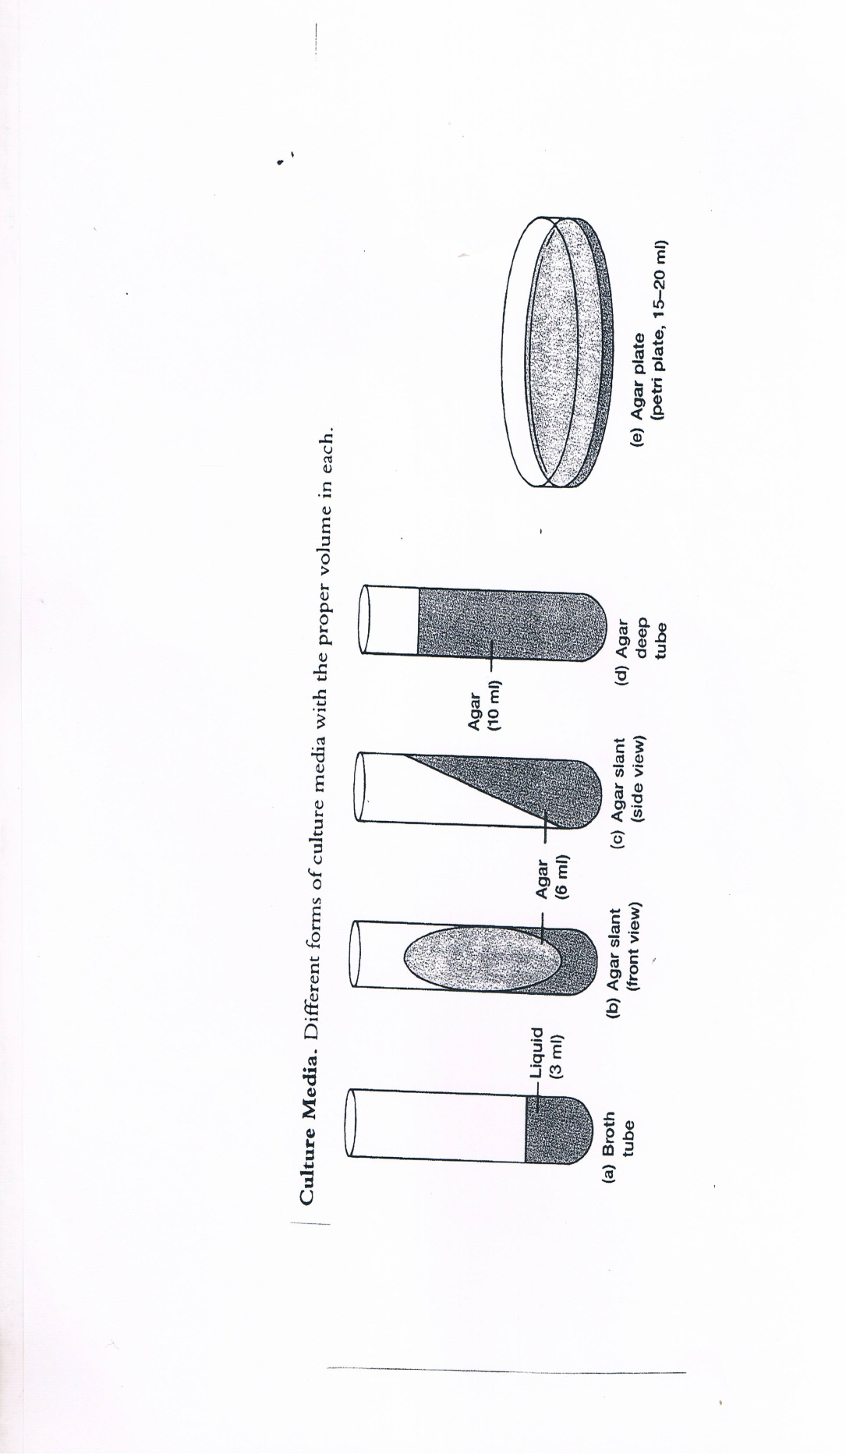
Figure (3):Different forms of culture media
Figure (2): a) Inoculating needle
b) Inoculating Loop
Figure (3):Different forms of culture media

Slide 13
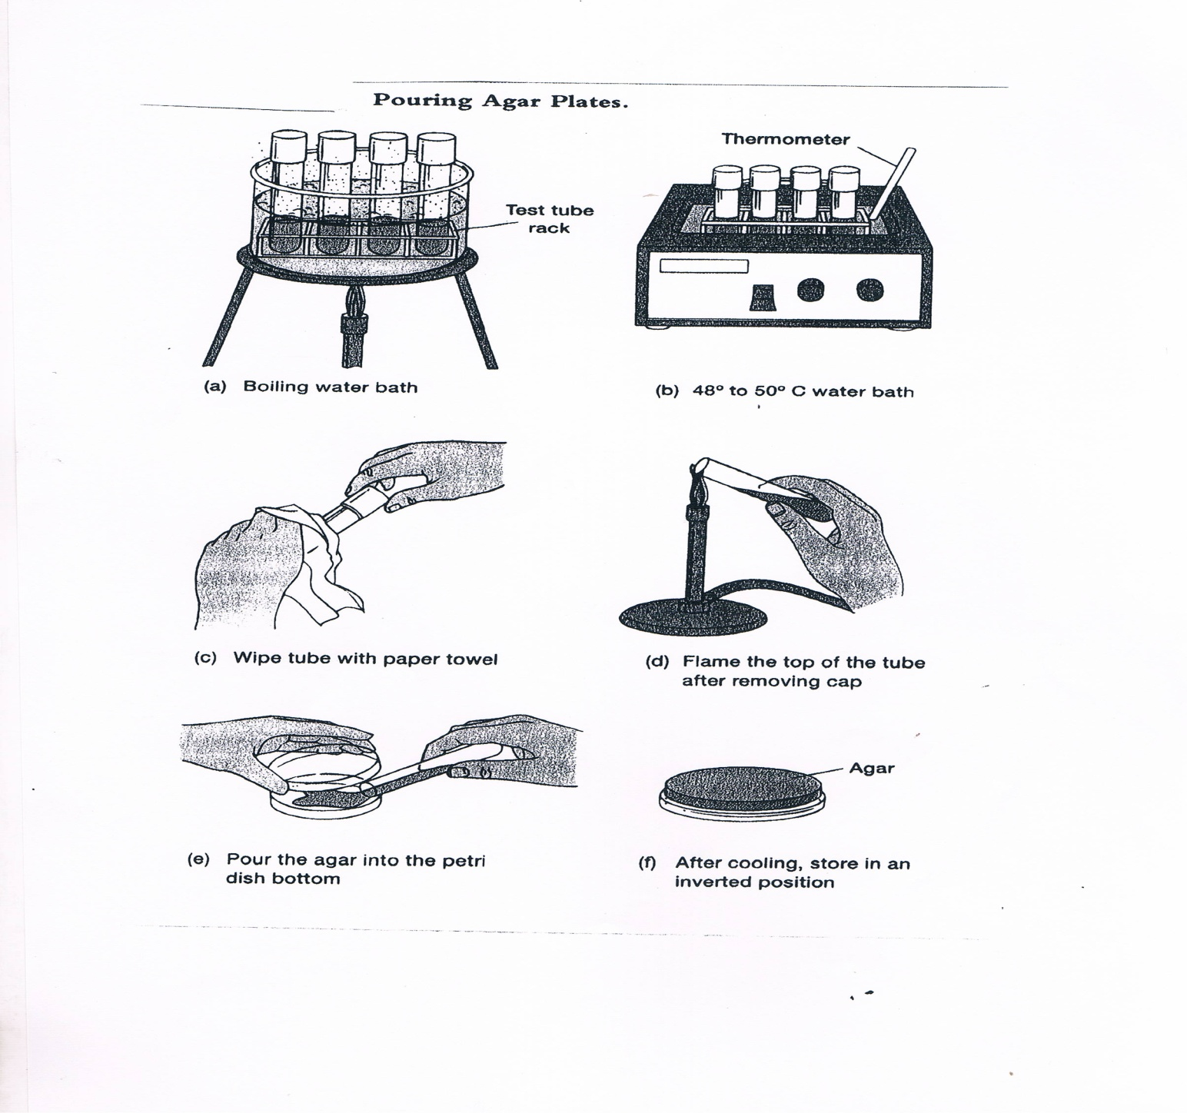
Figure (4): Pouring plate technique

Slide 14
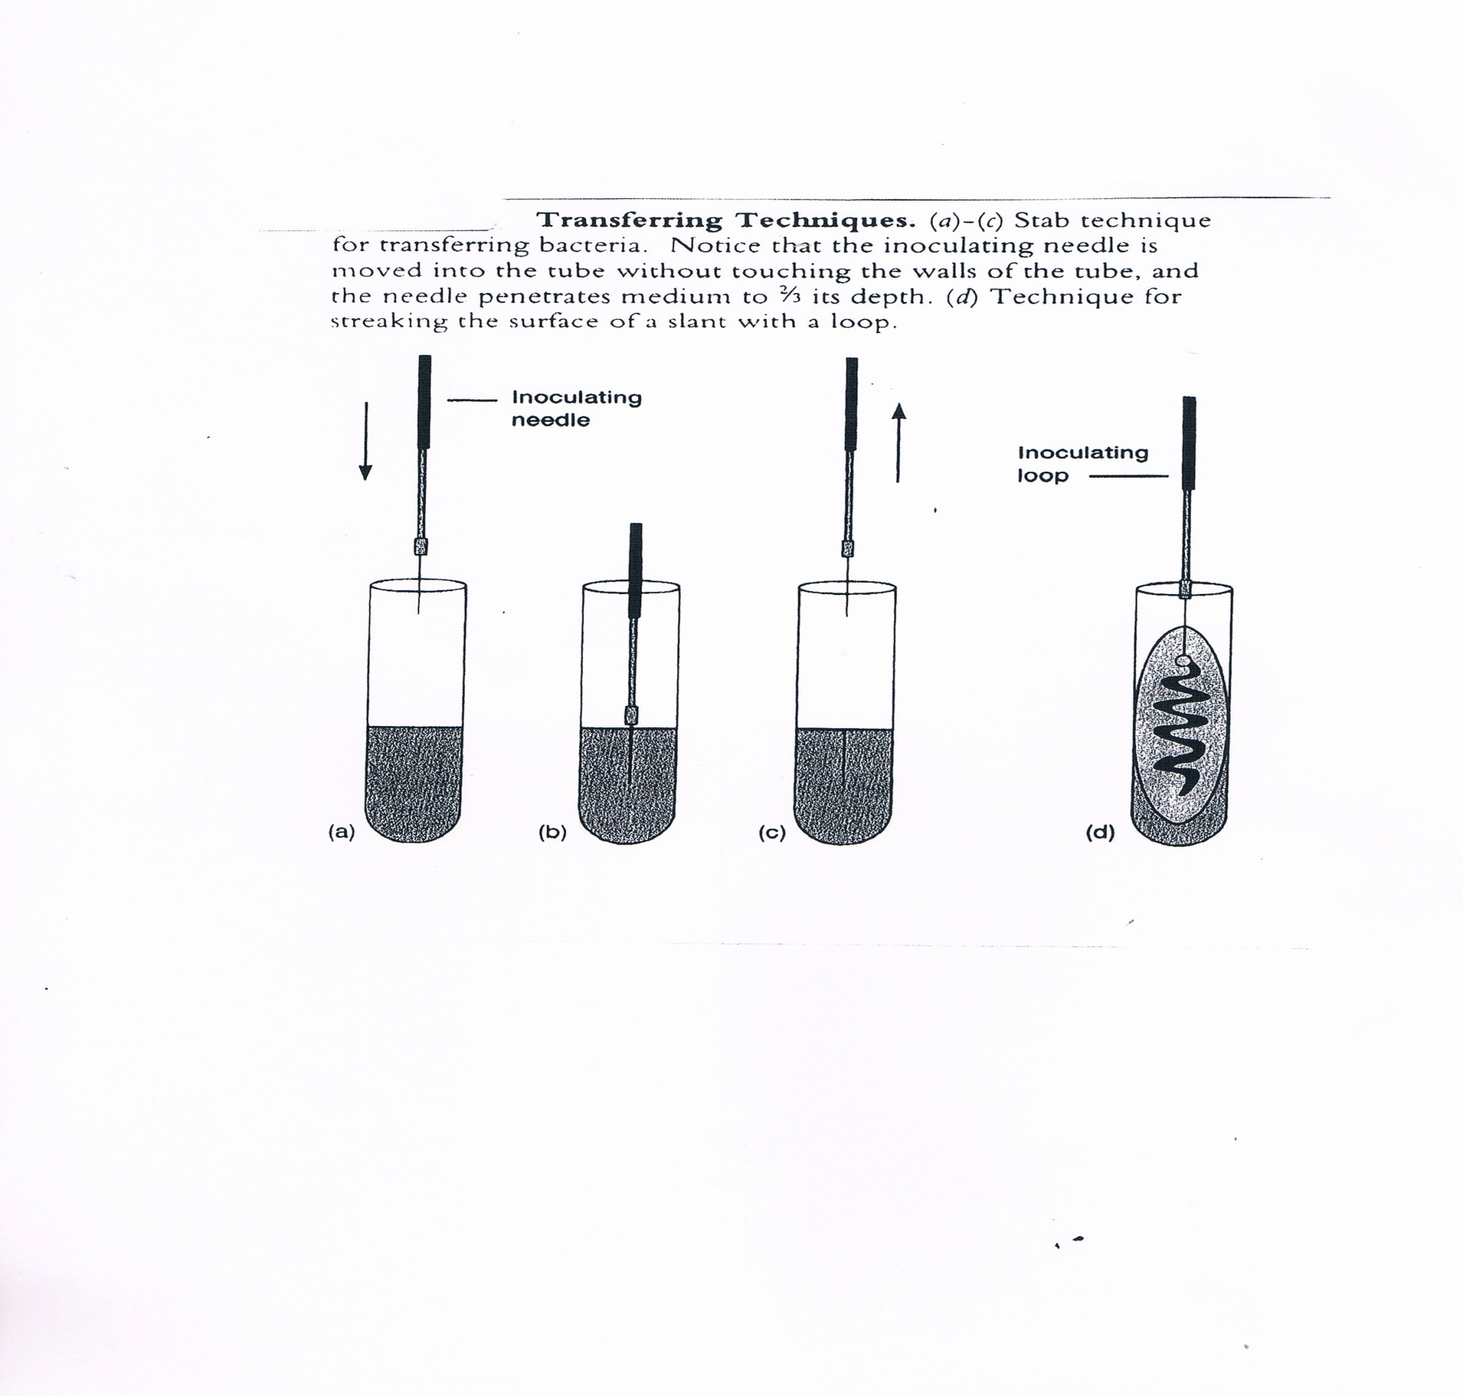
Figure (5) Transferring techniques

Slide 15
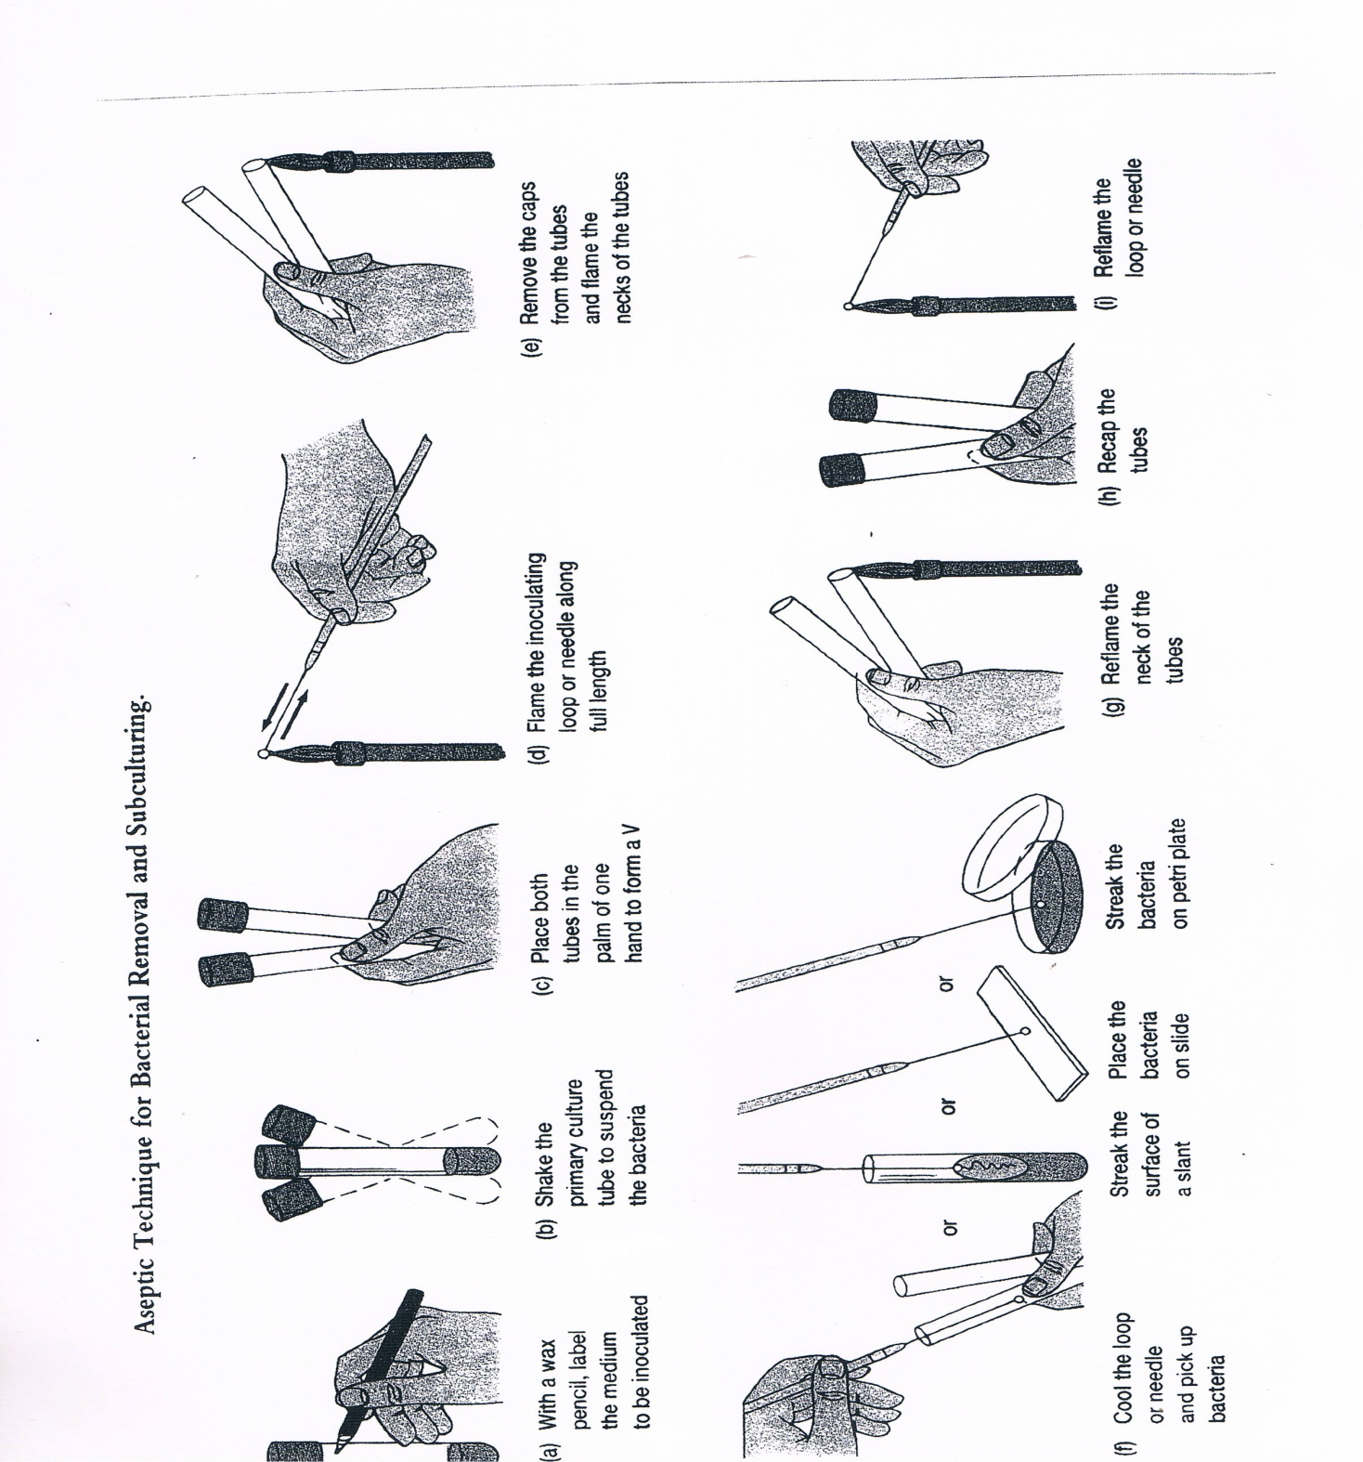
Figure (6):Aspetic technique and bacterial subculturing

Slide 16
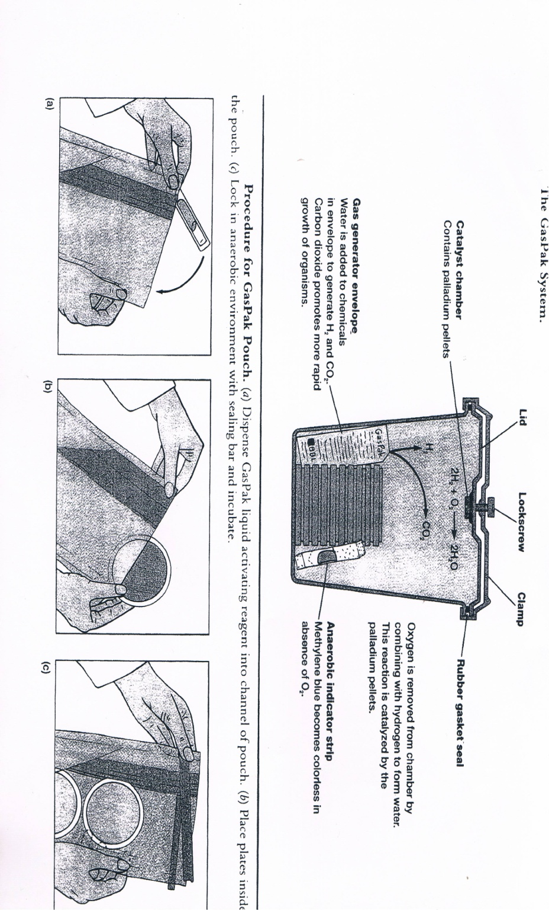
Figure (7): Incubation of anaerobic bacteria

